Slide 1
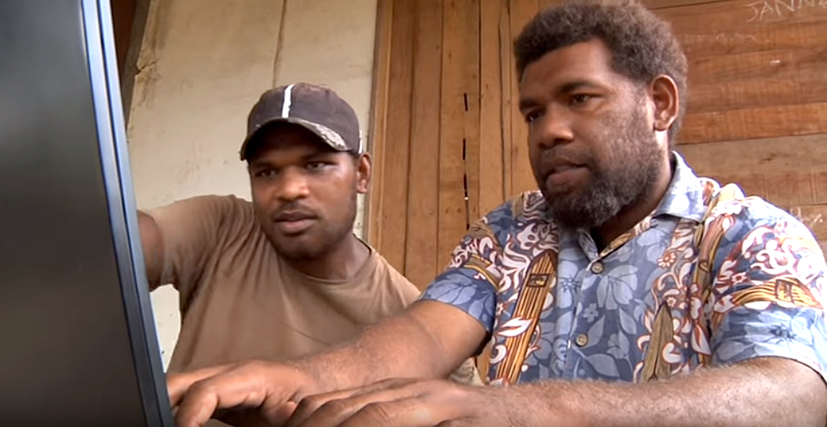
Checking Resources

Slide 2
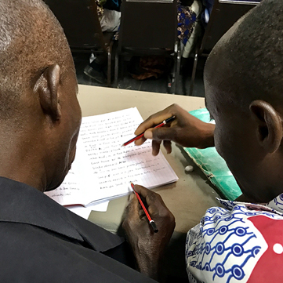
The Steps of MAST
Drafting Steps
Checking Steps
Consume
Verbalize
Chunk
Blind Draft
Self-edit
Peer-edit
Keyword check
Verse-by-verse check

Slide 3
?
Checking Steps
Which resources help with each step?
Self-edit
Peer-edit
Keyword check
Verse-by-verse check

Slide 4





Available Checking Resources
Translation Notes
Translation Words
Translation Questions
Unlocked Dynamic Bible

Slide 5
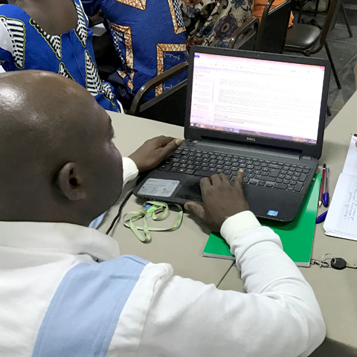


Accessing the Resources
Bibleineverylanguage.org

Slide 6

Try it
Read Matthew 19:24-25

Slide 7


